Slide 1



Real Time Fitness and Health(RTFH)
Amity University, Patna
Developed by:
Hemant Kumar Yadav (TeAm leader)
Rohit Kumar
Rishabh kumar
Shivam kumar
Aalok kumar
Under the guidance of : Mani Gautam Sir

Slide 2

Introduction
This app is related to health and fitness . Here you can get help and guidance about health and fitness, user can find disease According to their symptomps.

Slide 3
Objective
It consists of these following modules
Splash Screen
Login / Register scree
Home screen
Health (Physical & Mental health)
Fitness (Crossfit , Stretching , Yoga & Abs workout)

Slide 4
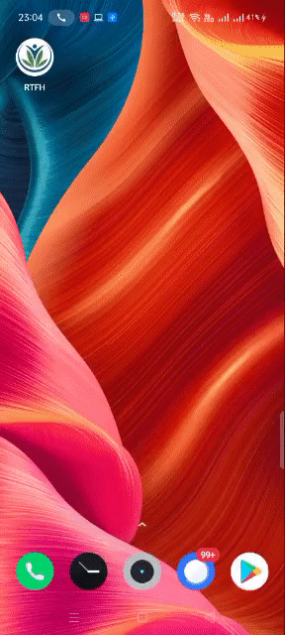
Splash Screen
Love this fit life
It is the very first page user will see after running the app, it shows the logo of the app and will disappear after few seconds.

Slide 5
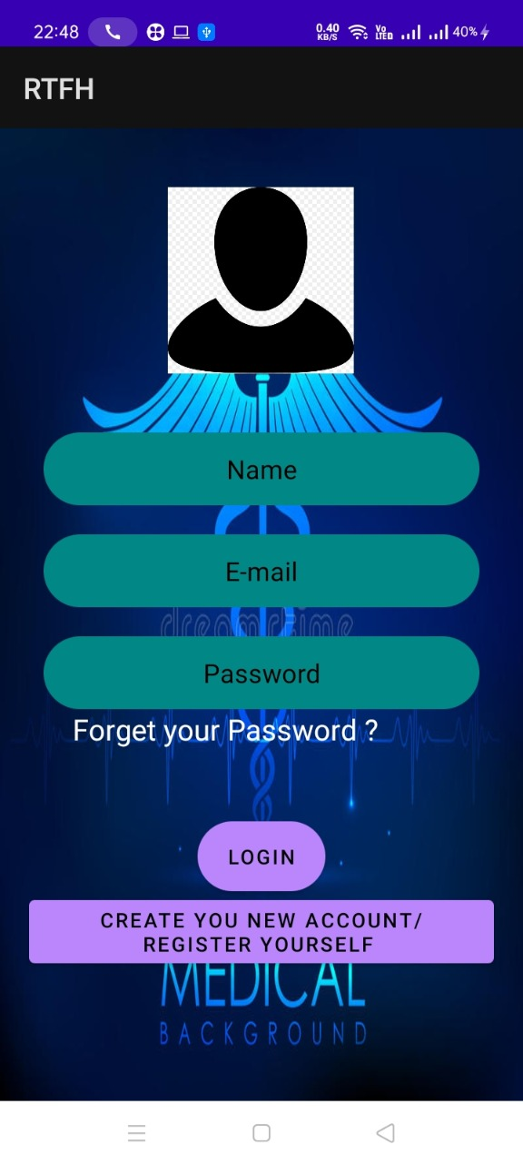
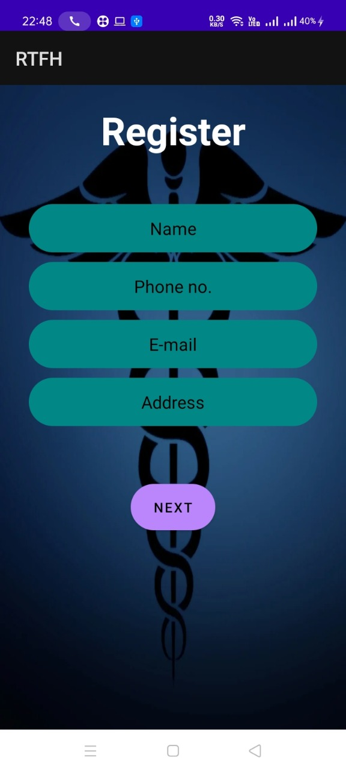
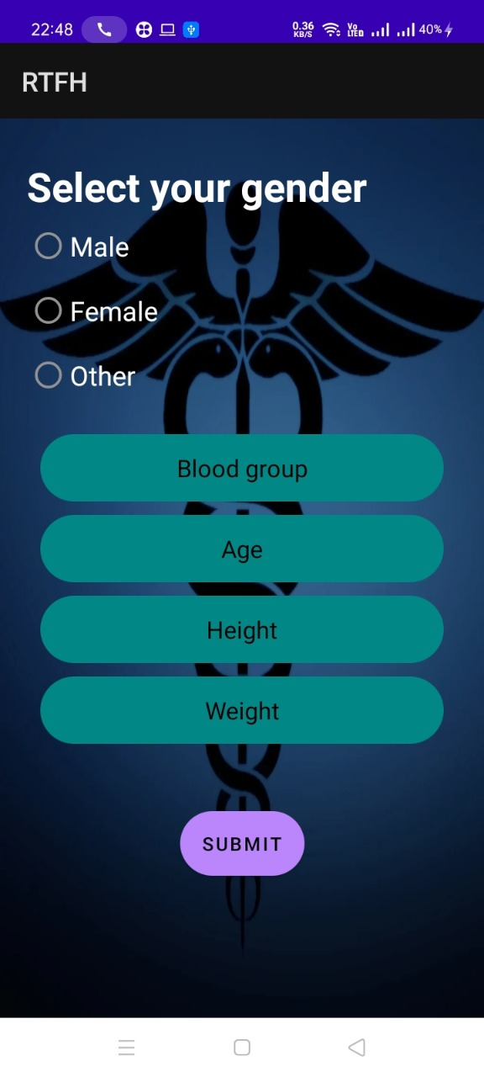
Login / Register page
Log in
Register
Here user can Login with the help of there user ID and password if they are already registered or they can simply Register
If the user forgets the password they can click on the “Forget your password ” button and can reset it using the directed browser .

Slide 6
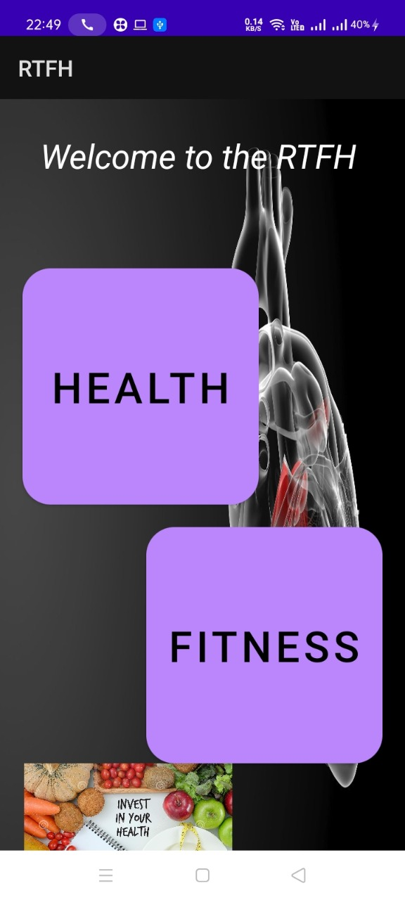
Home Screen
Home screen provides simply two buttons to the user ie. Health and Fitness.
User can select either of the two buttons according to their requirement.
These buttons are explained in the further slides.

Slide 7

Health
Here user can get help about Physical & mental health
Some glimpse of it are shown in the next two slide.

Slide 8
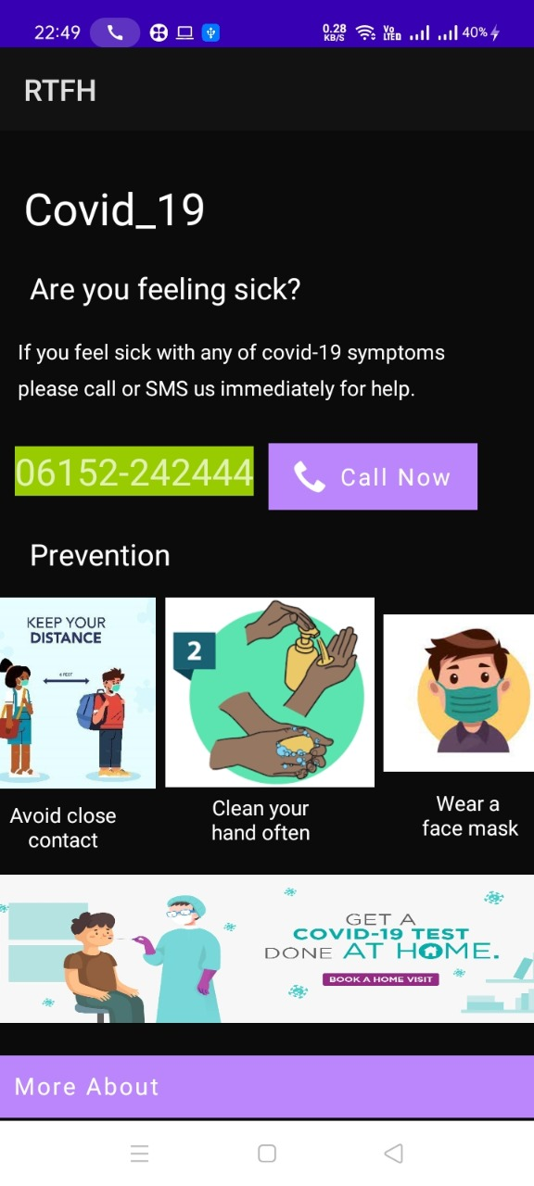
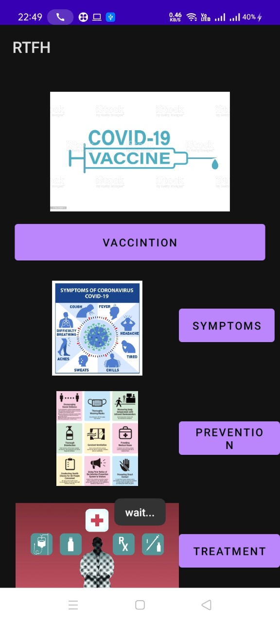
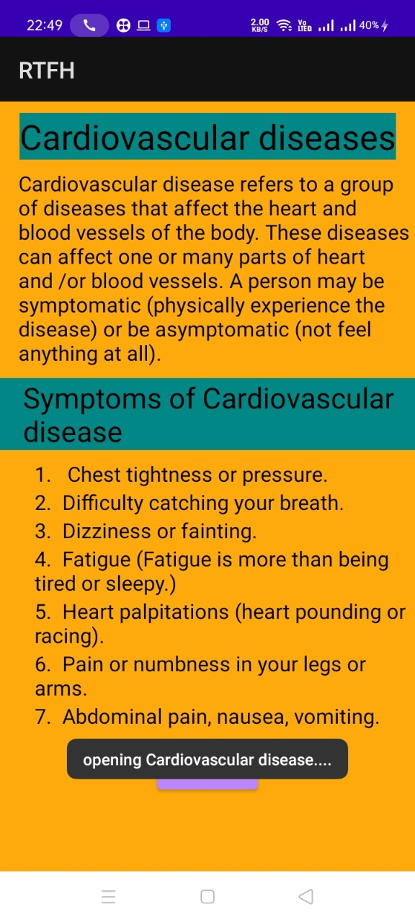
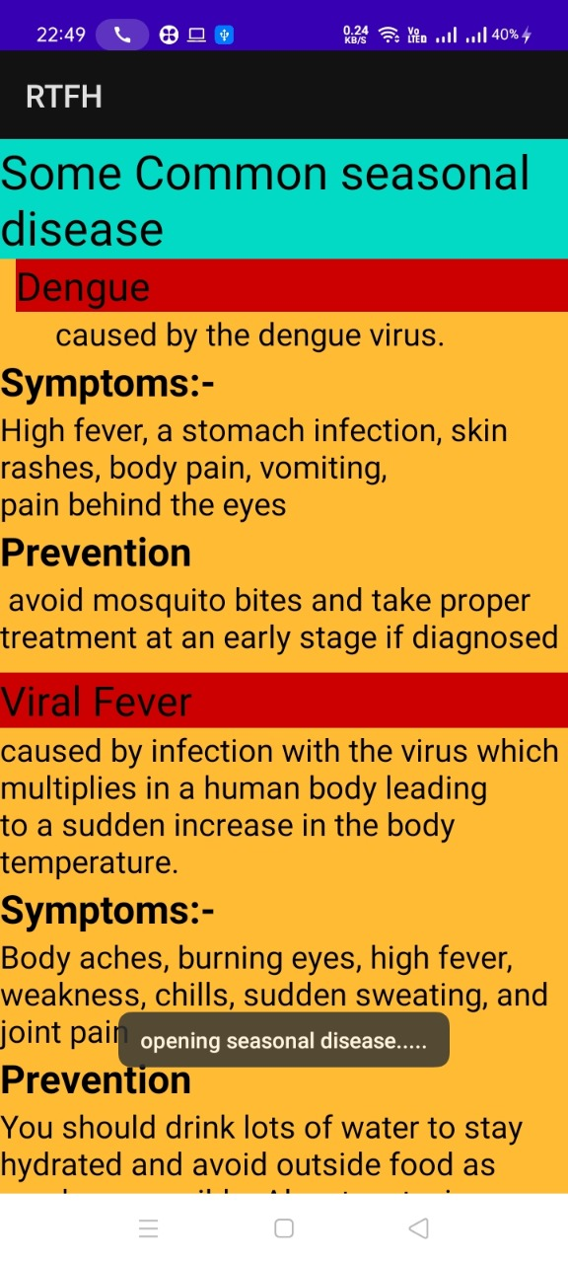
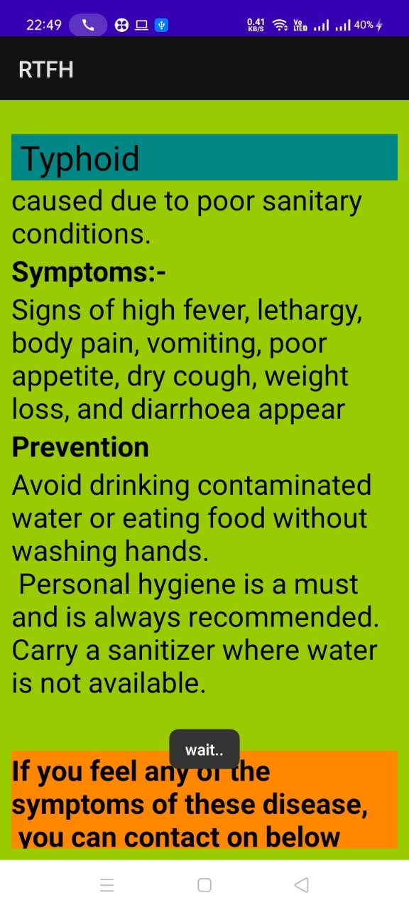

Slide 9
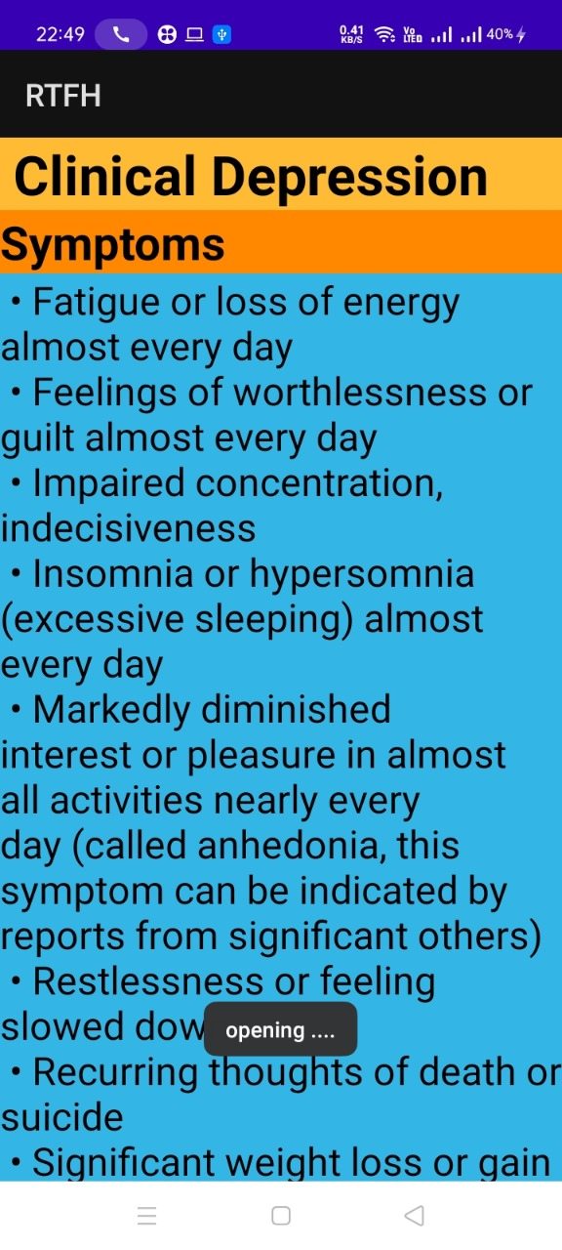

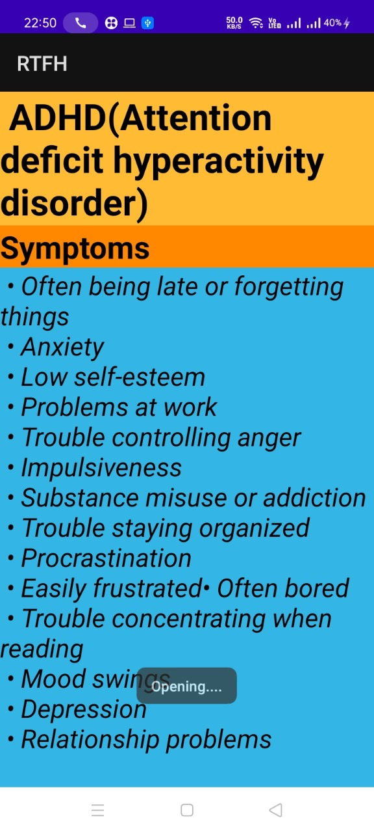
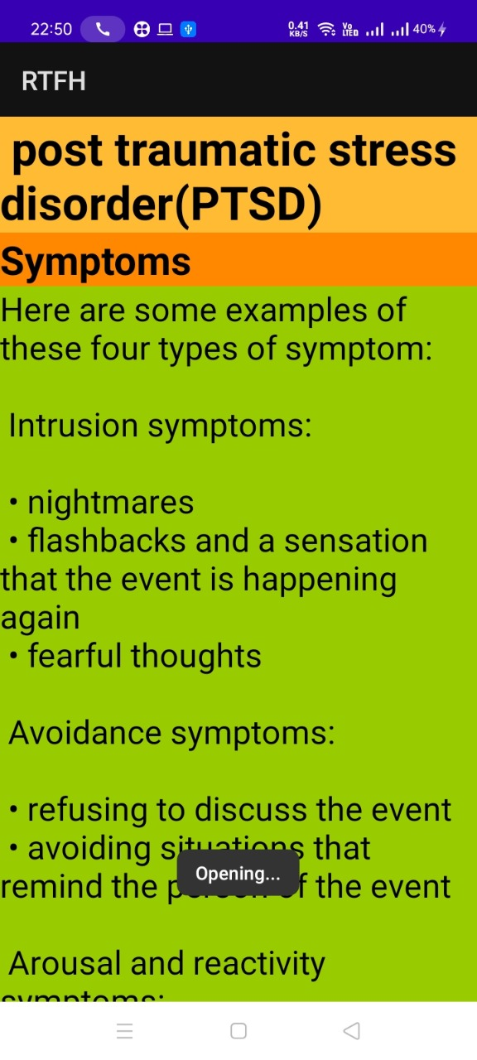

Slide 10
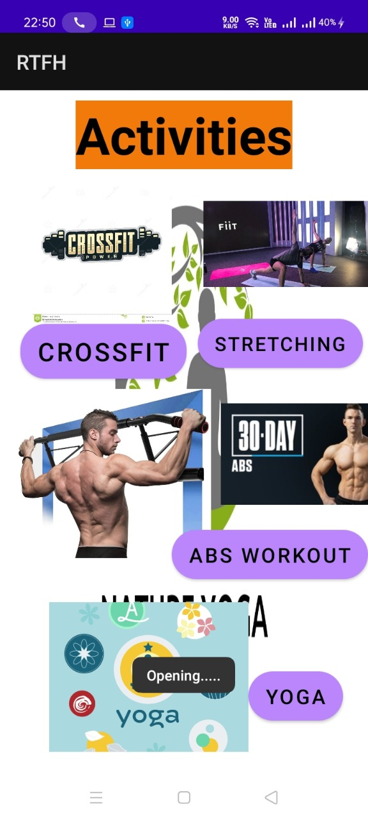
Fitness
Here user can get help about Fitness.
It consist different kind of workouts.
That helps one to stay fit.
Some glimpse of it are shown in the next slide.
Fitness

Slide 11
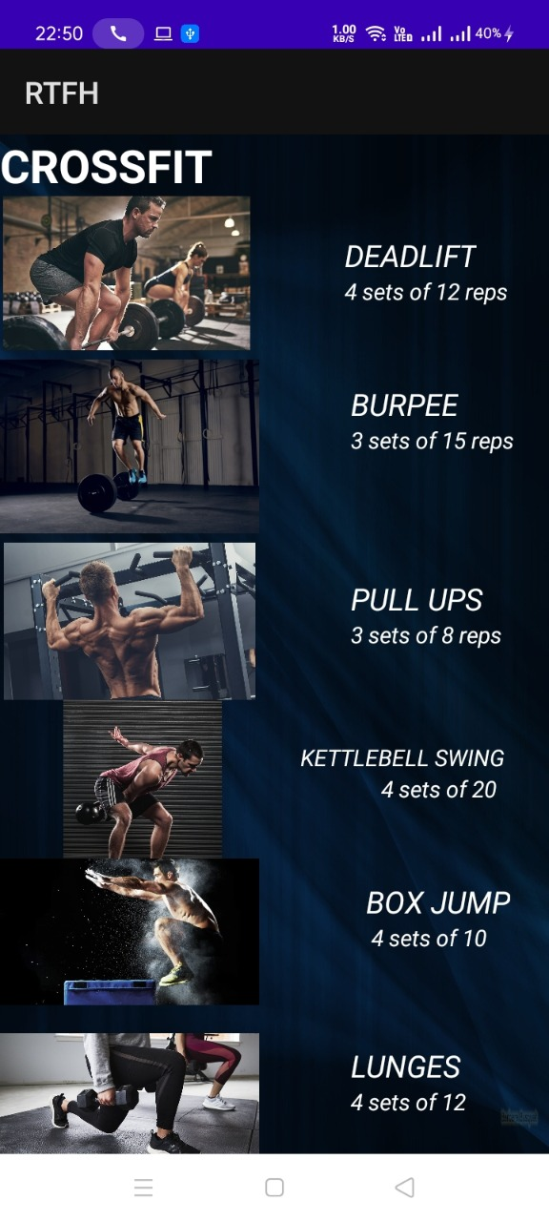
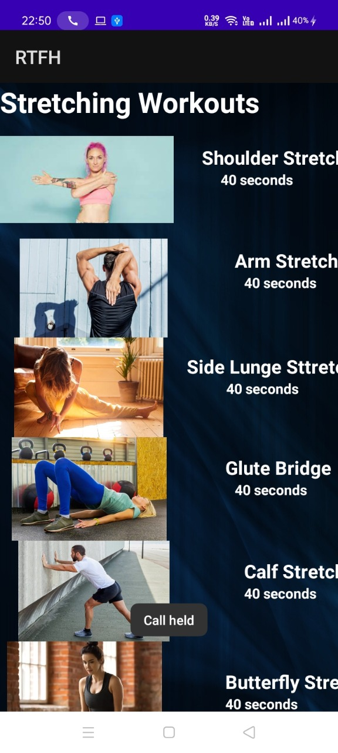
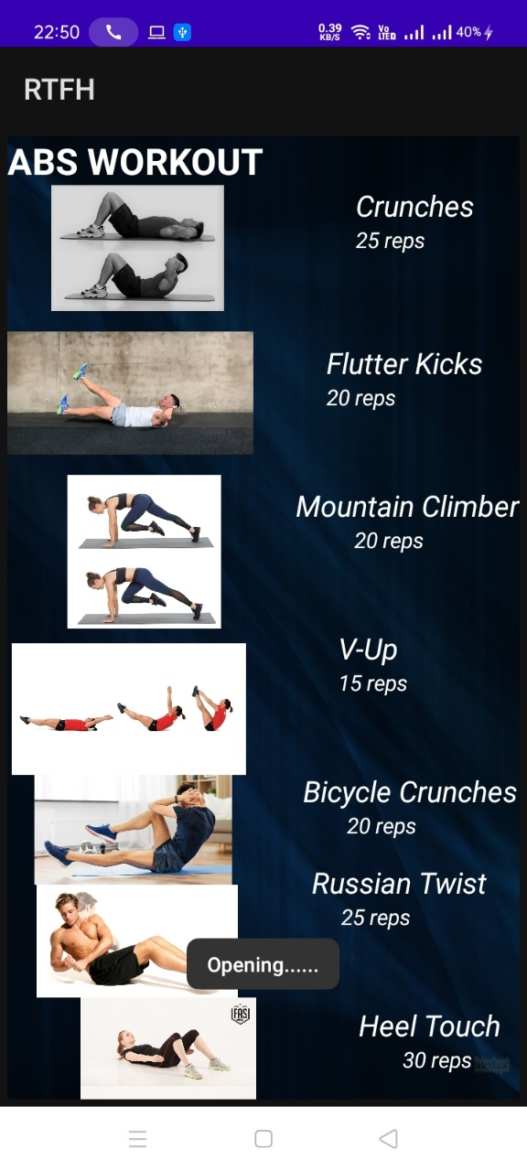
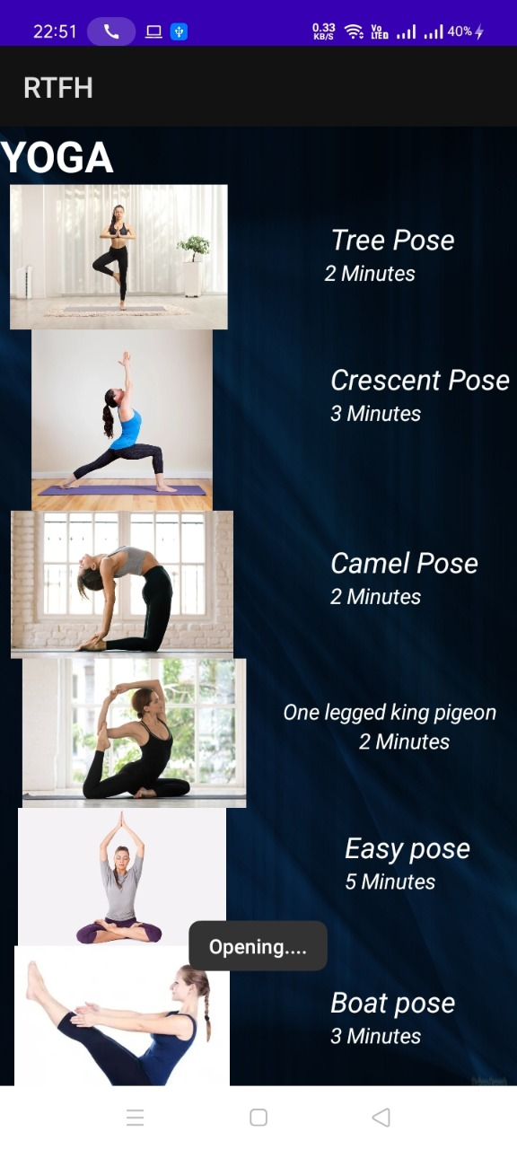

Slide 12



